Slide 1
DESIGN CONTINUED

Slide 2
Q. Design a computer having 8k of ROM starting at address 0, followed by 8k of RAM. It will also have a memory mapped, bidirectional I/O port at address 8000H. It has 16-bit address bus and 8-bit data bus.

Slide 3
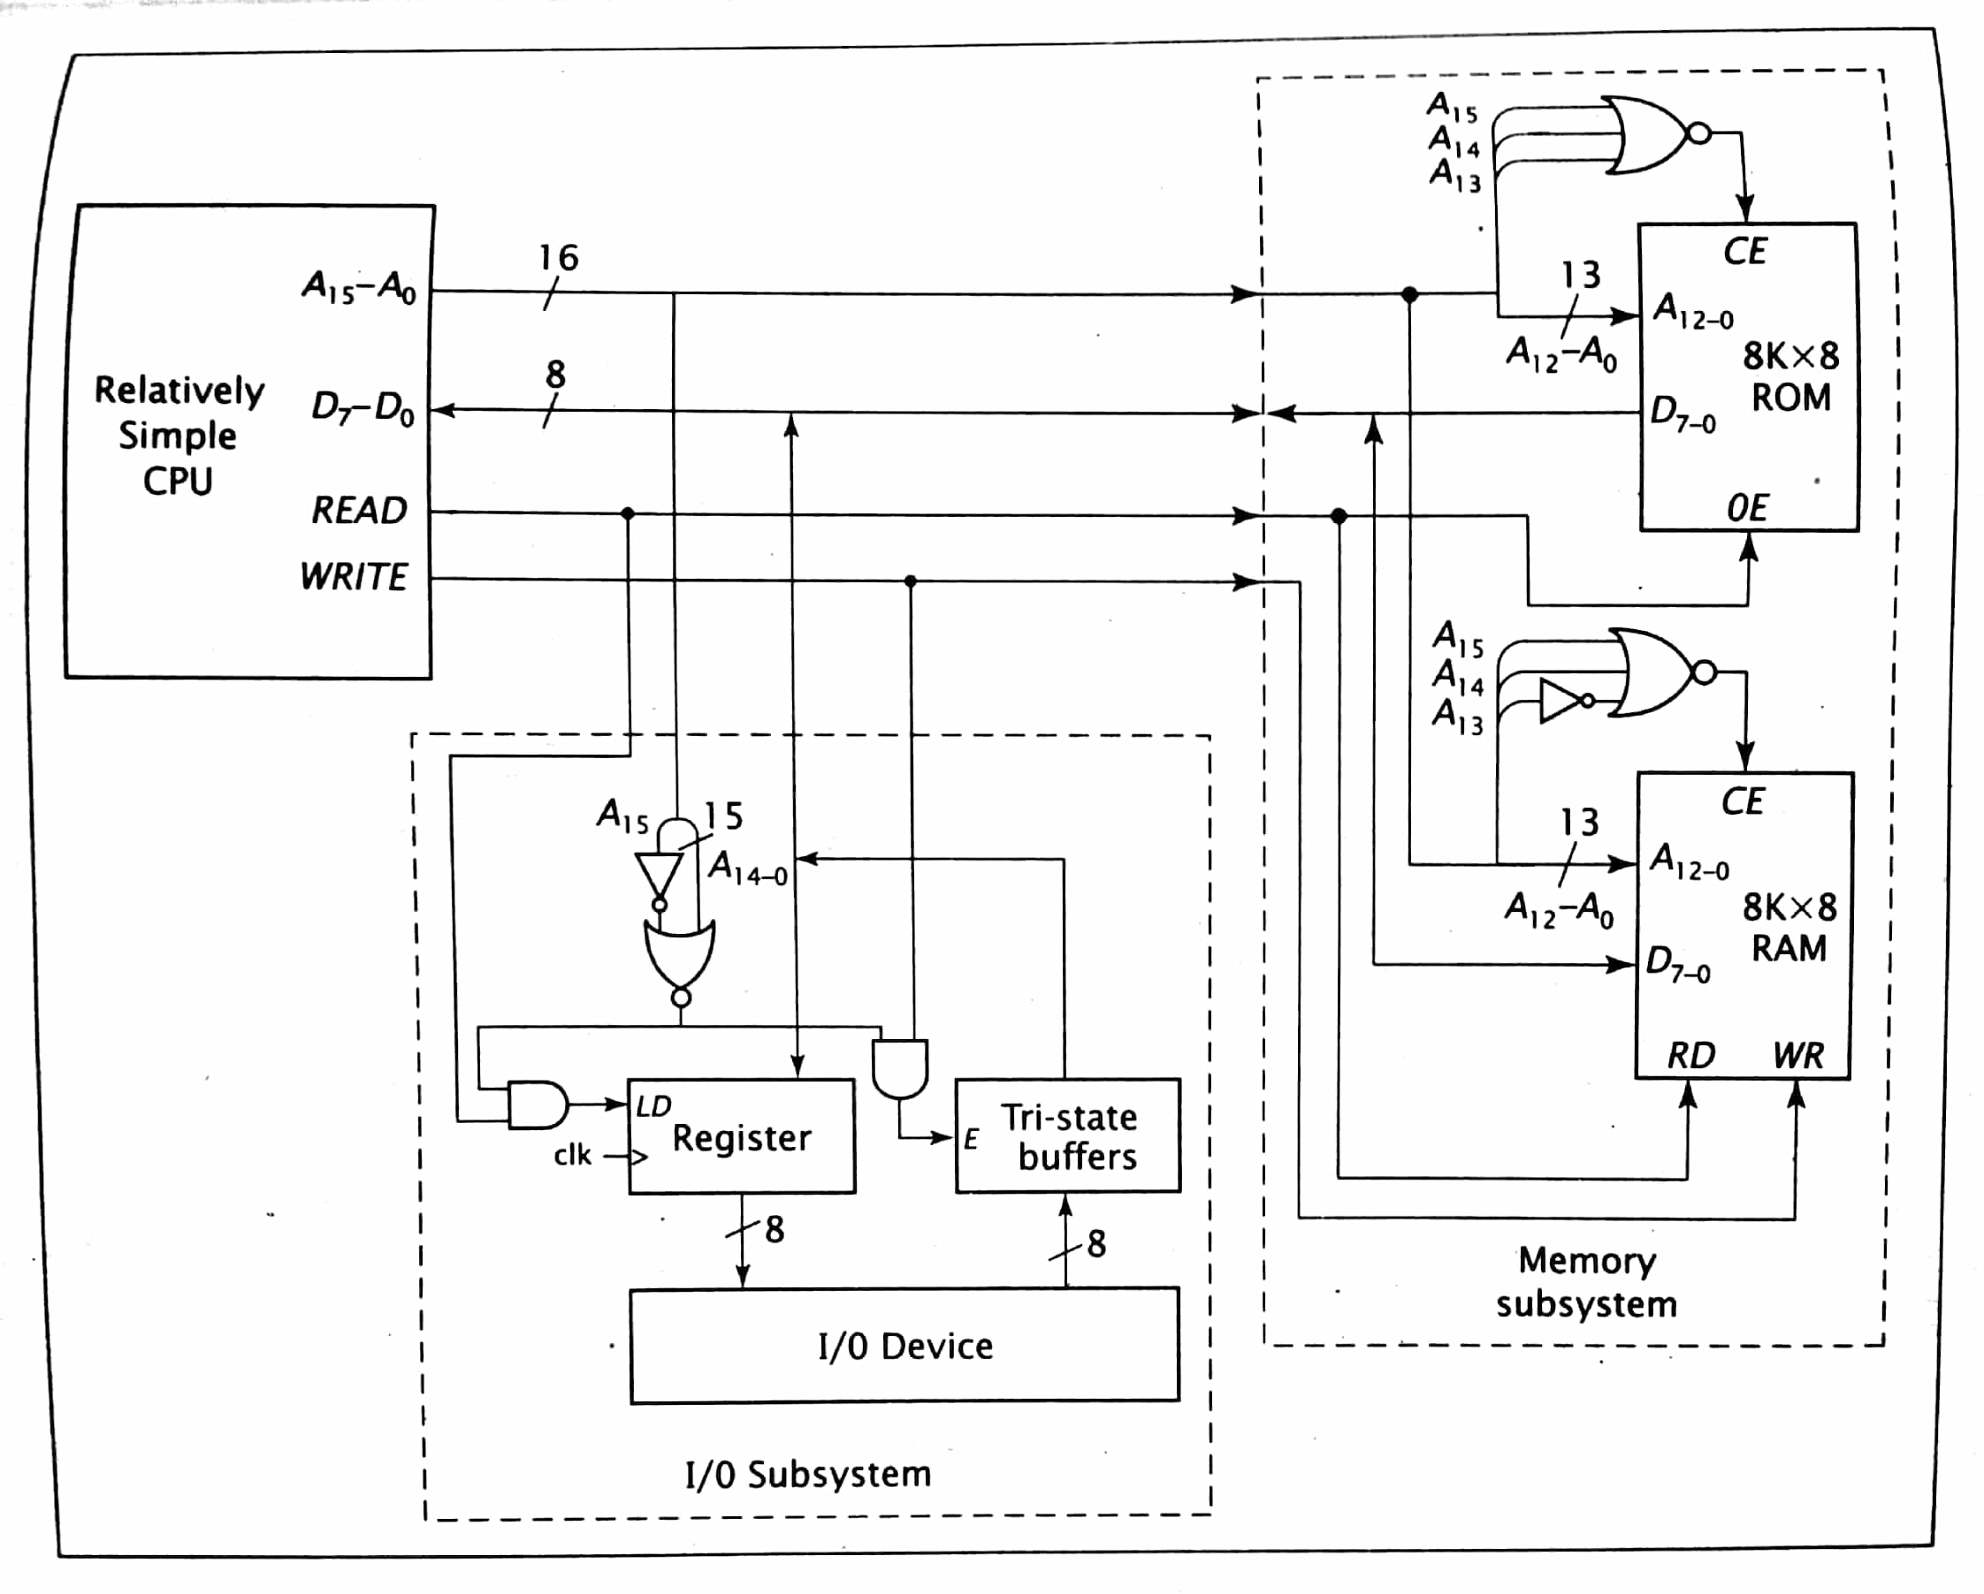
.

Slide 4
Q. A computer system with an 8-bit address bus and an 8-bit data bus uses isolated I/O. It has 128 bytes of EPROM starting at address 00H constructed using 128 x 2 chips; 32 bytes of RAM starting at address E0H constructed using 16 x 8 chips; an input device with a ready signal at address 00H; an output device with a READY signal at address FFH; and a bidirectional input/output device with no READY signal at address 80H. Show the design for this system. Include all enable and load logic.

Slide 5
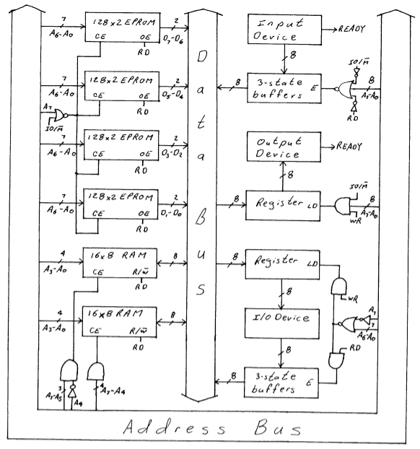
.

Slide 6
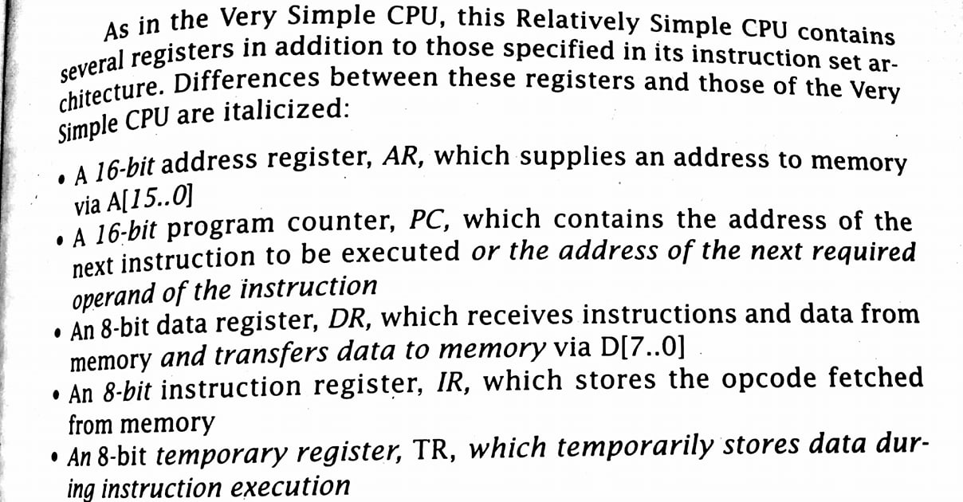
RELATIVELY SIMPLE CPU

Slide 7
Contd…
LDAC Instruction LDAC1: DR←M, PC←PC + 1, AR←AR + 1 LDAC2: TR←DR, DR←M, PC←PC + 1 LDAC3: AR←DR, TR LDAC4: DR←M LDAC5: AC←DR
STAC Instruction STAC1: DR←M, PC←PC + 1, AR←AR + 1 STAC2: TR←DR, DR←M, PC←PC + 1 STAC3: AR←DR, TR STAC4: DR←AC STAC5: M←DR

Slide 8
Execution trace of very simple CPU
Consider the following code segment: 0: ADD4 1: AND5 2: INC 3: JMP0 4: 27H 5: 39H
Initially all registers contain the value 0.

Slide 9
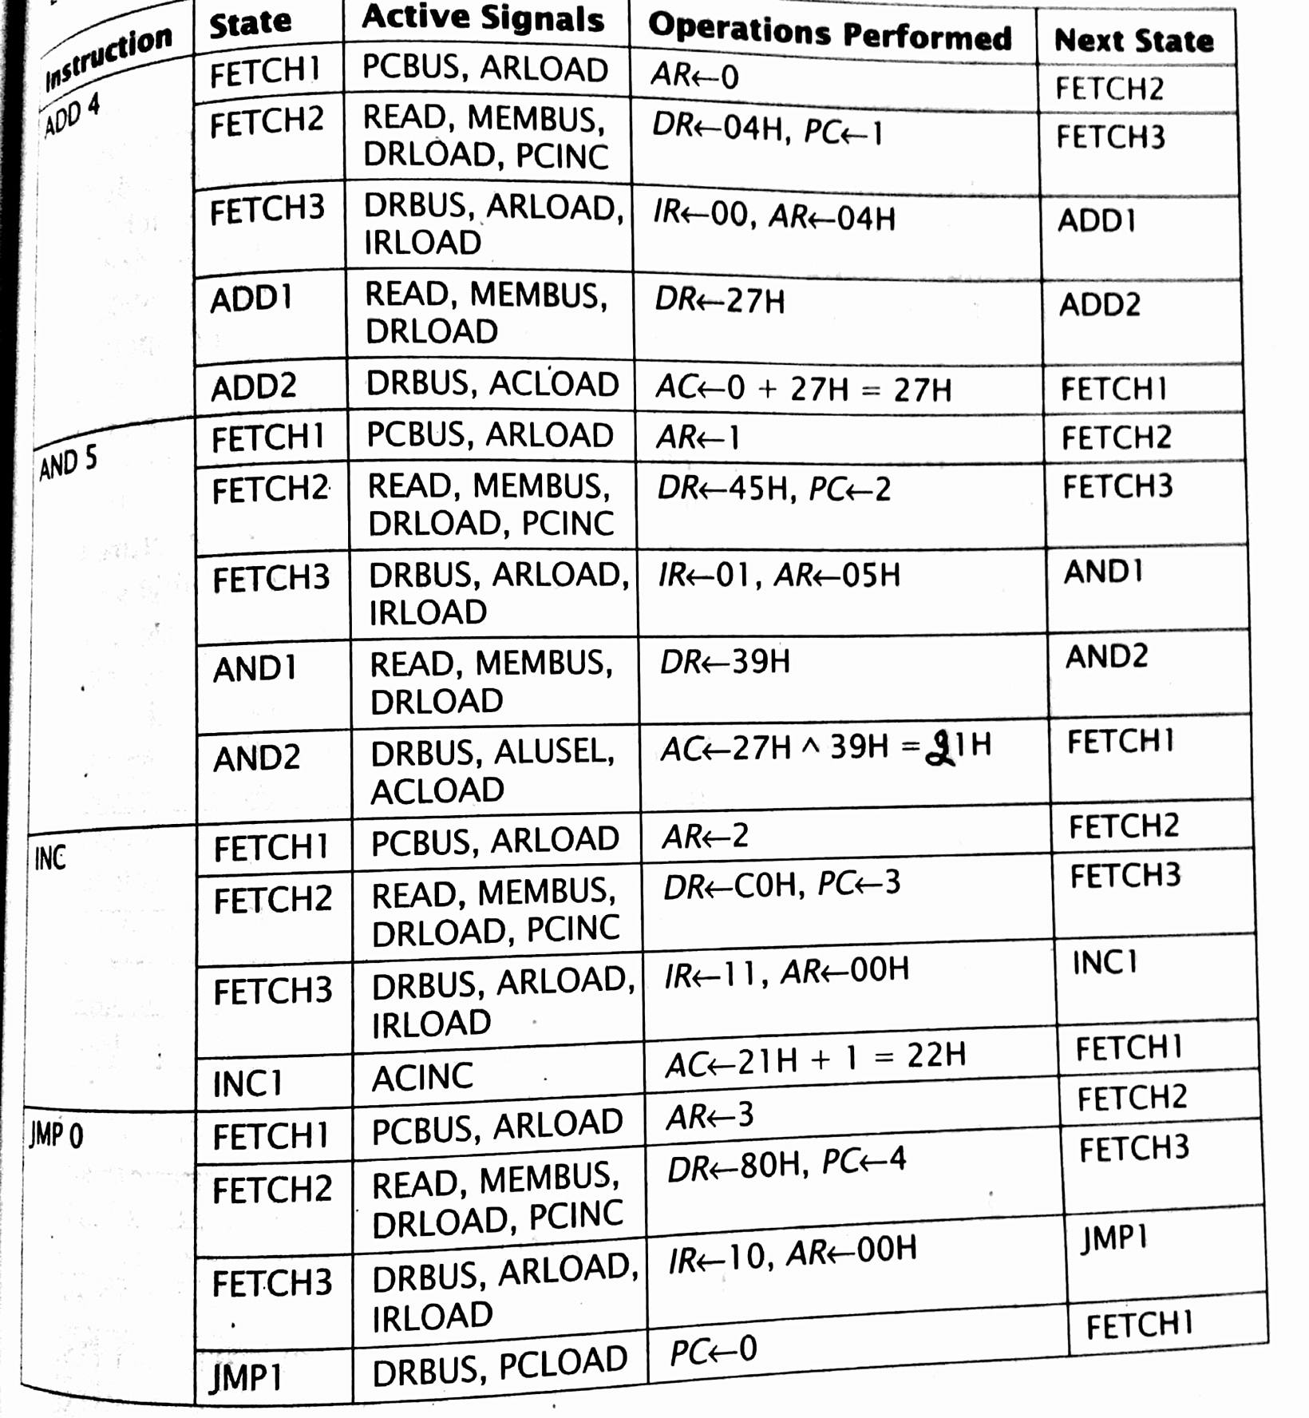
.

Slide 10
Design a 16 x 4 memory subsystem with high-order and low-order interleaving using 8 x 2 memory chips for a computer system with an 8-bit address bus.

Slide 11
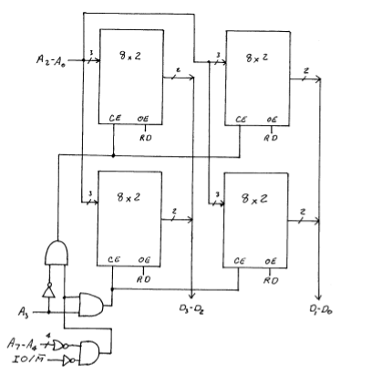

Slide 12
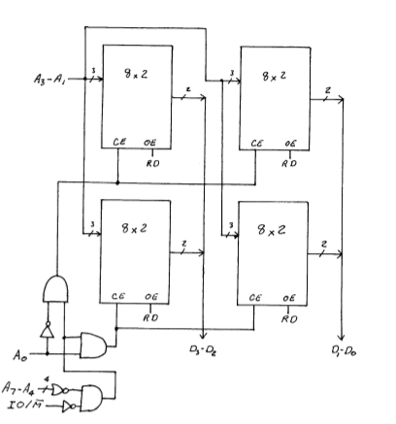

Slide 13
Show how the following values are stored in memory in big endian and little endian formats. Each value starts at location 22H. A. 12345678H b. 0927H c. 5551212H

Slide 14
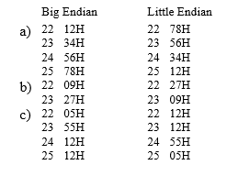

Slide 15
Assignment
A computer system with an 8-bit address bus and an 8-bit data bus uses memory mapped I/O. It has 32 bytes of ROM starting at address 00H constructed using 32 x 8 chip; 128 bytes of RAM starting at address 80H constructed using 64 x 4 chips; a bidirectional input/output device with no READY signal at address 40H; and an input device with no READY signal at address 60H. Show the design for this system. Include all enable and load logic.

